Slide 1



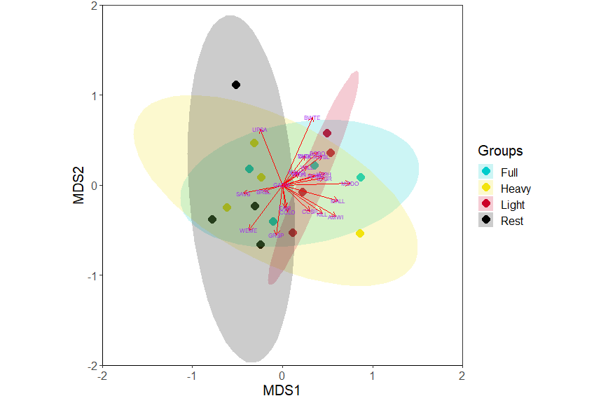

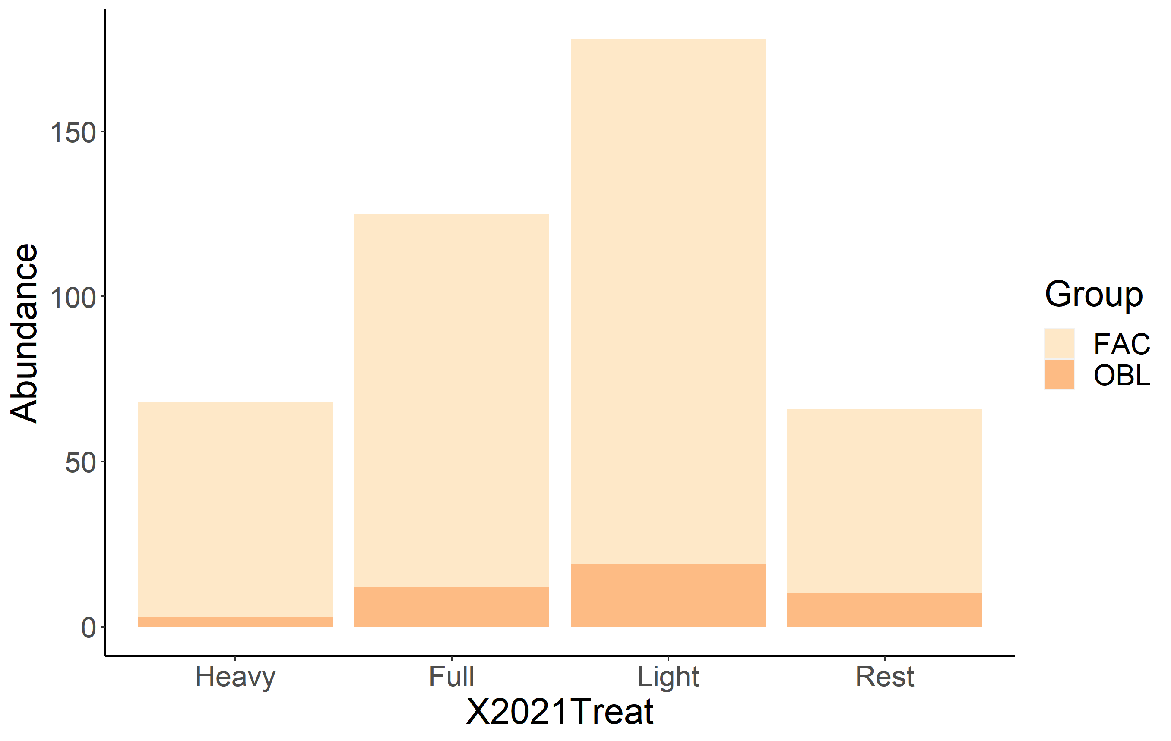
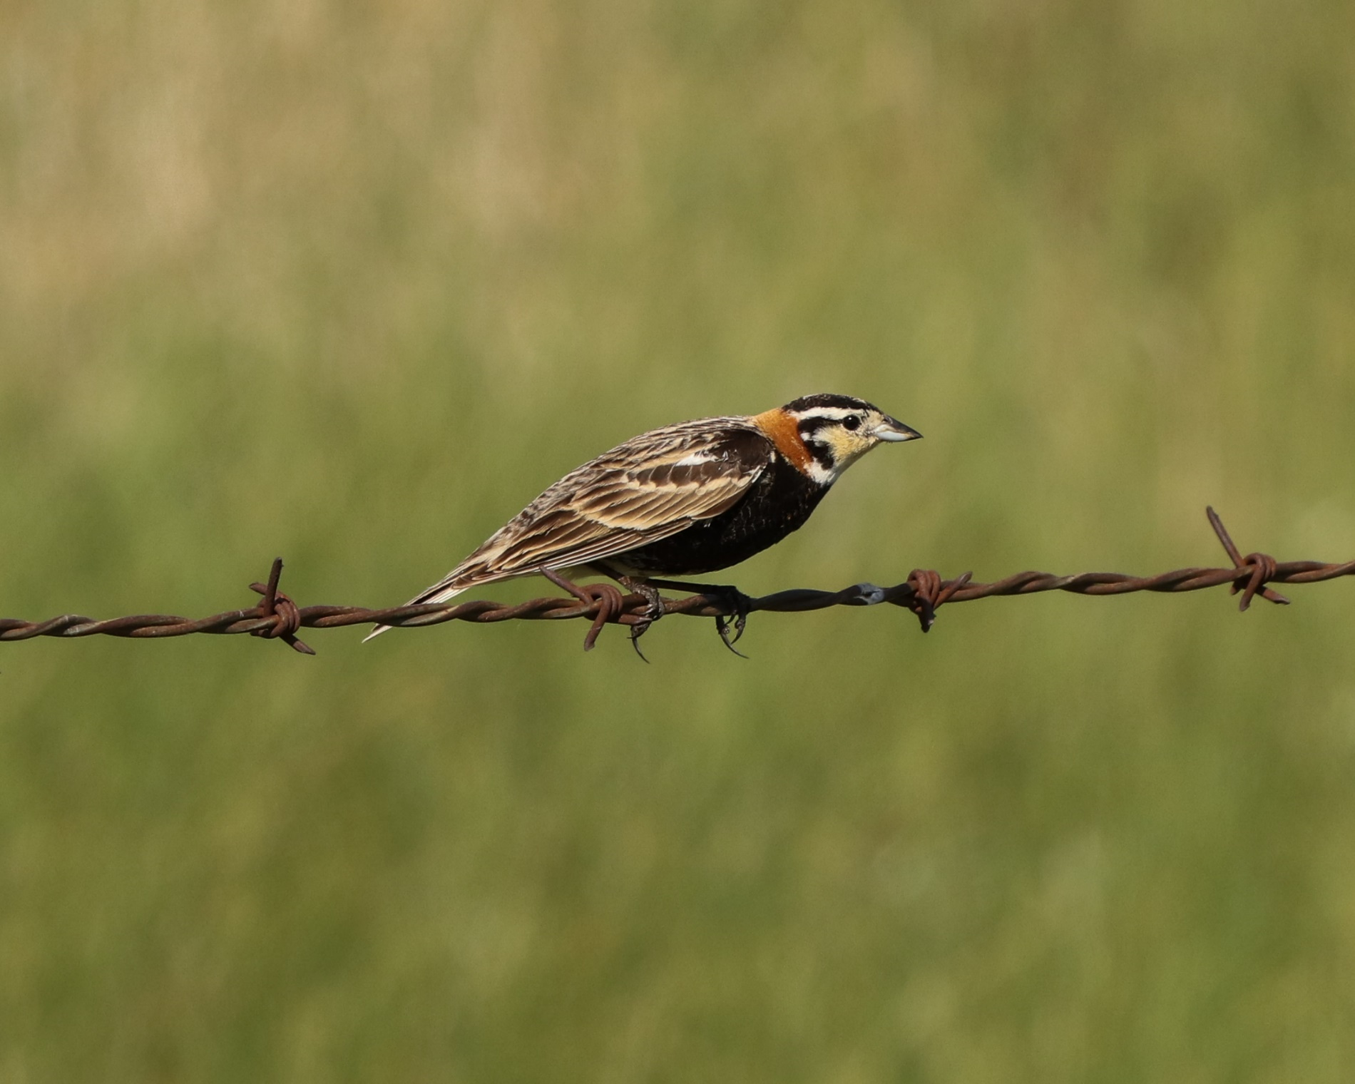
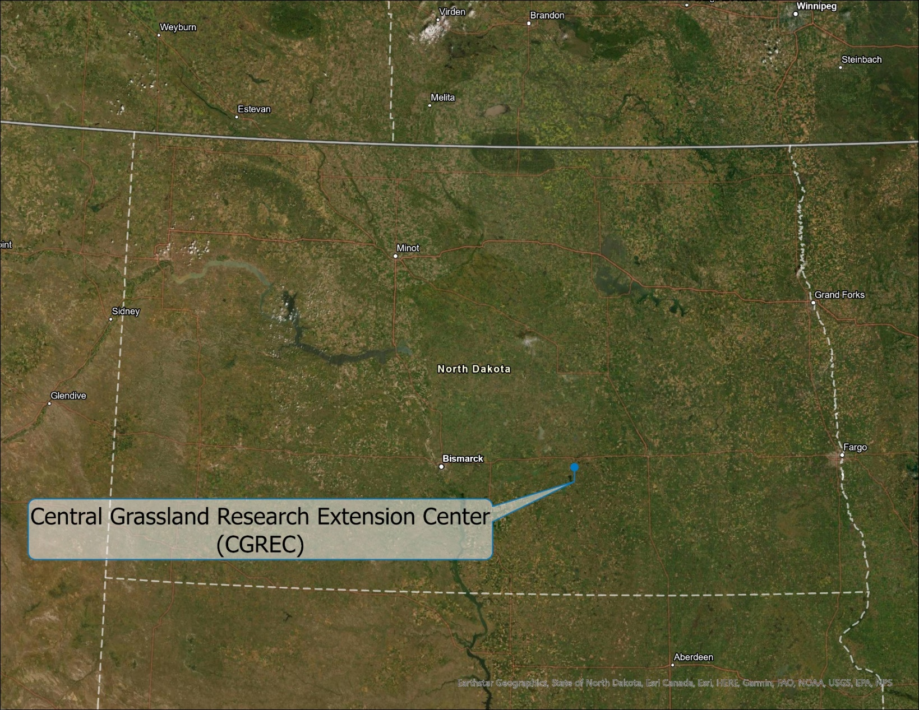

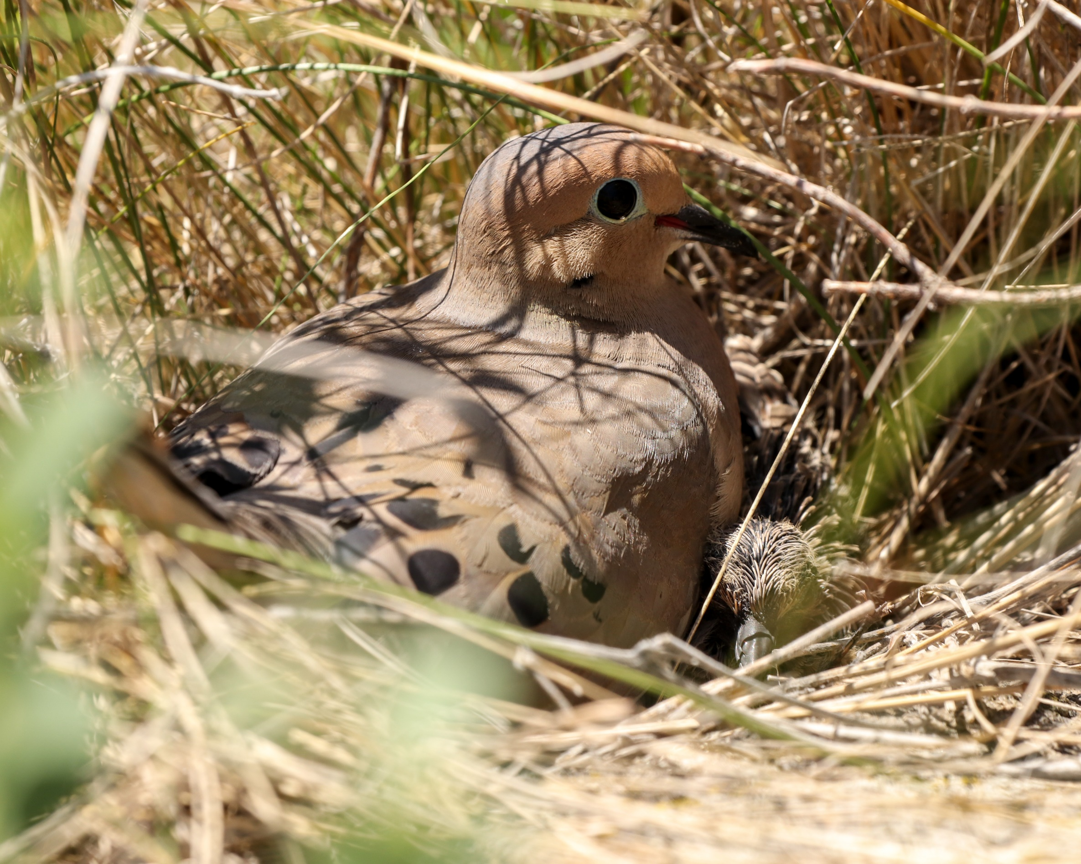
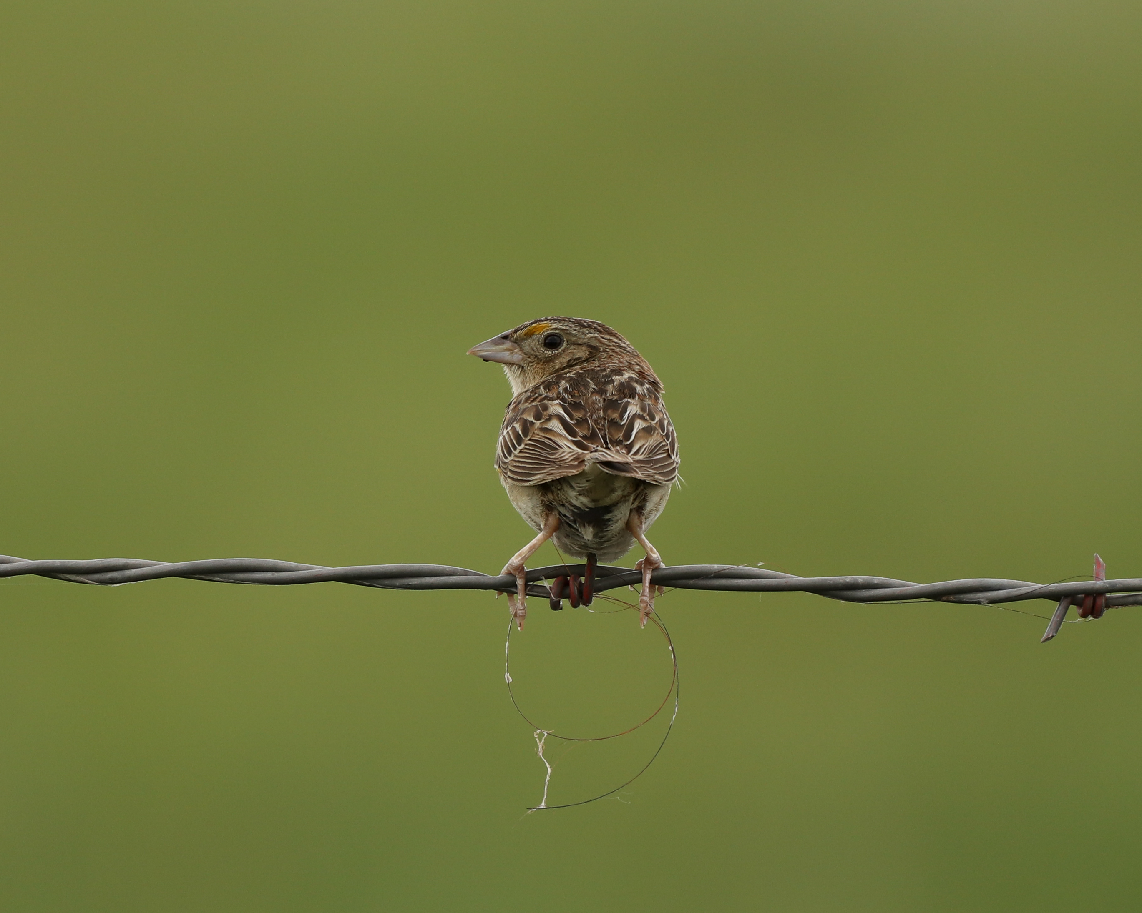
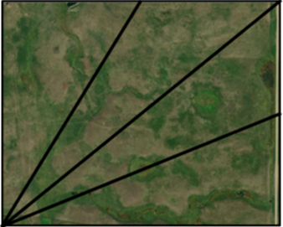
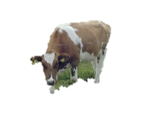
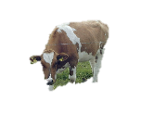

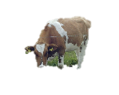

Breeding Bird Nesting Abundance in a Modified Twice-over Rest-rotation Grazing System
Justin Clarke¹, Torre Hovick¹, Kevin Sedivec^{1,2} , Ryan Limb¹, Jason Harmon¹, Ben Geaumont³
¹ School of Natural Resource Sciences, North Dakota State University, ² Central Grasslands Research Extension Center, ³ Hettinger Research Extension Center
Background
Results
Current management negatively influences avian diversity by creating homogenous landscapes through uniform grazing practices and altered or suppressed fire regimes.
Research has shown that restoring disturbance regimes can increase heterogeneity which increases avian biodiversity.
Fire and grazing interactions are effective at establishing heterogeneity, but many regions have a cultural aversion to fire which requires creative management practices to restore heterogeneity.
OBJECTIVE: A modified twice-over
rest-rotation grazing system
should create structural heterogeneity
in vegetation which suits the habitat
needs of a variety of avian species,
thus increasing avian biodiversity.
There was no significant difference in nesting composition between treatments (ANOSIM; p=0.093). Avian nesting richness was highest in the full and light treatments and nest abundance was almost double in the full and light treatments compared to the heavy and rest treatments.
Treatment | Avian Nesting Richness
Heavy | 10
Full | 18
Light | 19
Rest | 12
Heavy
Full
FAC
Light
Rest
OBL
Methods
The ordination shows differences in avian nesting abundance between paddock treatments where more distant points are more dissimilar. Species are overlaid; longer arrows indicate environmental factors that more strongly differentiate the sites. Ellipses show 95% confidence intervals.
The stacked bar plot shows the number of nesting individuals in each treatment. Nesting species are divided up into facultative grassland birds and obligate grassland birds
(Vickery et al. 1999).
We conducted nest drags from late-May to mid-July
We used a 30m rope with cans tied every 5m
Dragging occurred between 0530 and 1100
Each paddock was dragged 4 times
Stocking rates were maintained at 2.76 AUM/ha
Implications/Future Objectives
References
Variation in grazing intensity influences grassland bird nesting communities.
These results are preliminary and based on data collected during a period of extreme drought.
Research will continue for several years examining the impacts of a modified twice-over rest-rotation grazing system on nesting success.
These results have the potential to establish an alternative to fire-based management for vegetation structural heterogeneity utilizing a modified twice-over rest-rotation grazing system.
Partial funding comes from the NDSU College of Graduate and Interdisciplinary Studies.
contact information: justin.r.clarke@ndsu.edu
Fuhlendorf SD, Engle DM (2001) Restoring heterogeneity on rangelands: Ecosystem management based on evolutionary grazing patterns. Bioscience 51(8):625–632.
Hovick TJ, Dwayne Elmore R, Fuhlendorf SD (2014) Structural heterogeneity increases diversity of non-breeding grassland birds. Ecosphere 5(5):62.
Sliwinski MS, Burbach ME, Powell LA, Schacht WH (2018) Factors influencing ranchers ’ intentions to manage for vegetation heterogeneity and promote cross-boundary management in the northern Great Plains, 23(4).
Sauer JR, Link WA, Fallon JE, et al (2013) The North American Breeding Bird Survey 1966–2011: Summary Analysis and Species Accounts. North American Fauna 79:1–32.
Vickery, P.D., Tubaro, P.L., Cardosa da Silva, J.M. (1999(. Conservation of Grassland Birds in the Western Hemisphere. Studies in Avian Biology 19:2-26.
contact information: justin.r.clarke@ndsu.edu
Modified Twice-over Rest-rotation Grazing System
Pastures are divided into four grazing intensities based on utilization
Light Intensity (20-40% utilization)
Full Intensity (40-60% utilization)
Heavy Intensity (60+% utilization)
Rested (0% utilization)

